Slide 1
DTSA 5509
Supervised Machine Learning Model for Alzheimer’s Diagnosis

Slide 2
Problem Statement
Use cognitive and functional assessments to predict Alzheimer’s diagnosis
Create screening process that does not rely in clinical/medical tests
Identify Alzheimer’s earlier

Slide 3

Data
Source
El Kharoua, R. (2024). Alzheimer’s Disease Dataset. https://www.kaggle.com/dsv/8668279.
Overview
2,149 patients
35 columns
Demographic details, lifestyle factors, medical history, clinical measurements, cognitive and functional assessments, and symptoms

Slide 4
Approach
Supervised learning
Classification to predict binary Alzheimer’s diagnosis
Split data into 80/20 training and test subsets
Multiple ML models
Simple linear regression
Feature Engineering
Multiple linear regression (with and without interactions)
Multi-layer perceptron classifier

Slide 5
Data Cleaning
MMSE (Float)
Mini-Mental State Examination score, ranging from 0 to 30. Lower scores indicate cognitive impairment.
FunctionalAssessment (Float)
Functional assessment score, ranging from 0 to 10. Lower scores indicate greater impairment.
MemoryComplaints (Int)
Presence of memory complaints, where 0 indicates No and 1 indicates Yes.
BehavioralProblems (Int)
Presence of behavioral problems, where 0 indicates No and 1 indicates Yes.
ADL (Float)
Activities of Daily Living score, ranging from 0 to 10. Lower scores indicate greater impairment.
Diagnosis (Int)
Diagnosis status for Alzheimer’s Disease, where 0 indicates No and 1 indicates Yes

Slide 6
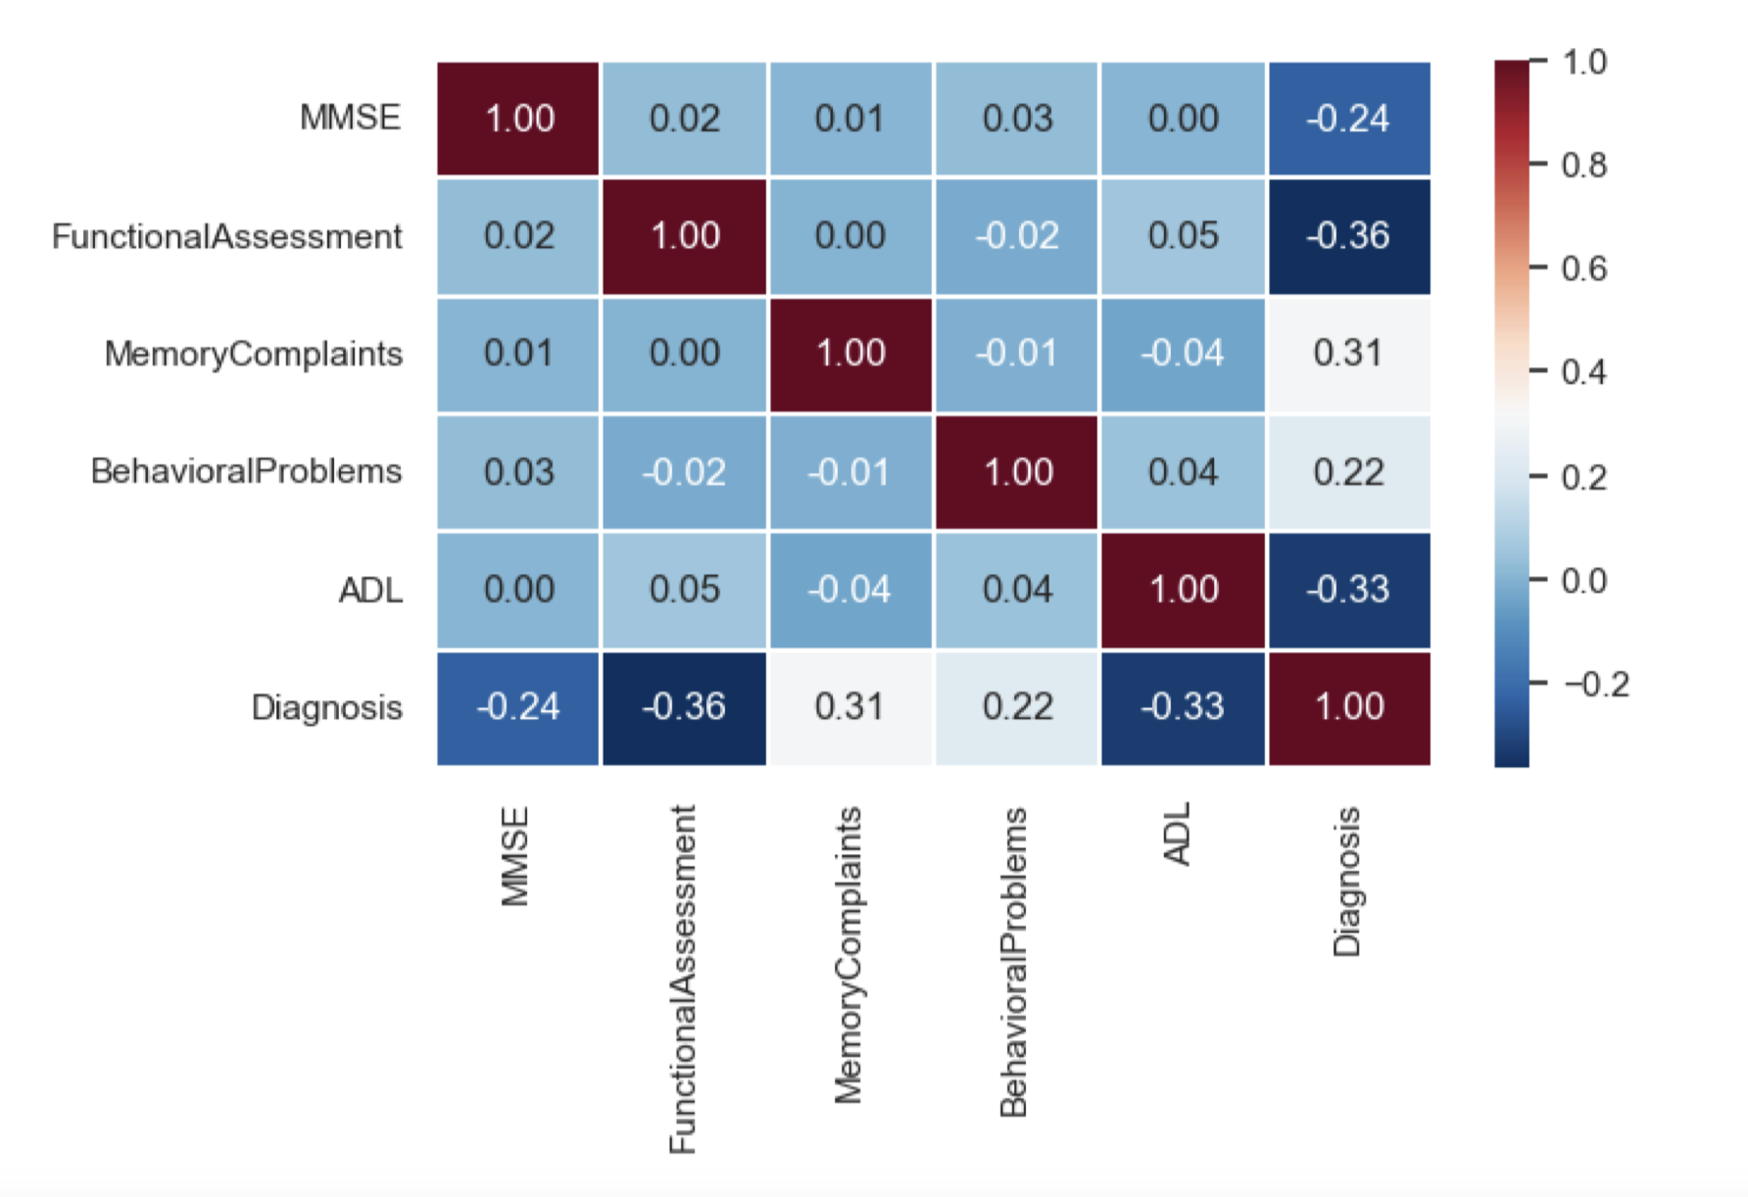
EDA

Slide 7
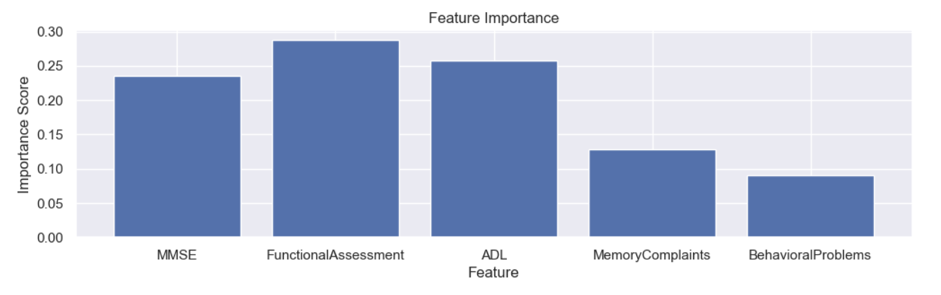
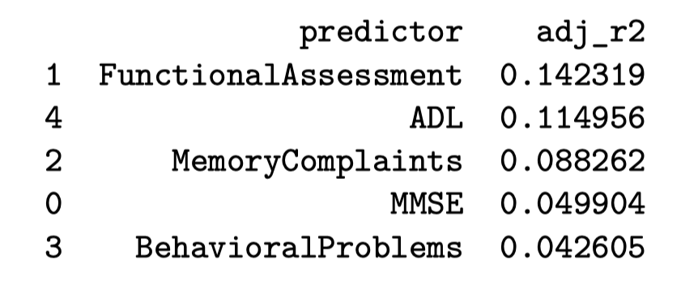
Simple Linear Regression

Slide 8
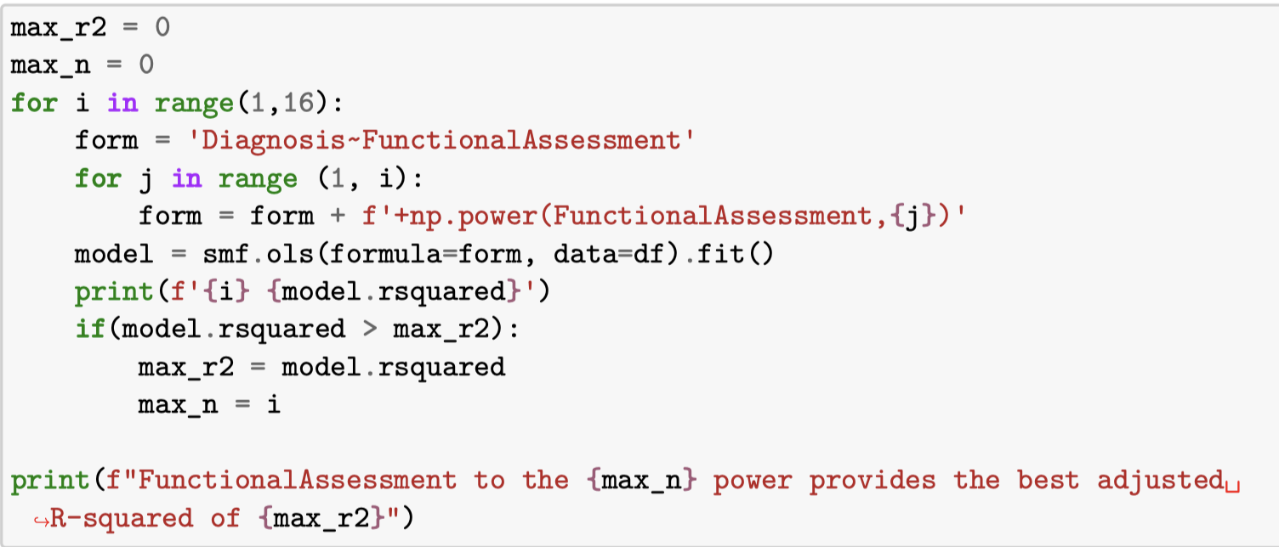
Feature Engineering
FunctionalAssessment to the 14 power provides
Adjusted R-squared of 0.171

Slide 9
Multiple Linear Regression
formula='Diagnosis~ FunctionalAssessment+ADL+ MemoryComplaints+ BehavioralProblems+MMSE’
Adjusted R-squared: 0.428
All coefficients statistically significant

Slide 10
Interaction Terms
Statistically insignificant interaction terms removed
'Diagnosis~FunctionalAssessment+ADL+MemoryComplaints+ BehavioralProblems+MMSE+ FunctionalAssessment*ADL+ FunctionalAssessment*MMSE+ ADL*MMSE+ MemoryComplaints*MMSE+ BehavioralProblems*MMSE’
Adjusted R-squared: 0.489

Slide 11
Multi-layer Perceptron Classifier
Neural network iteratively adjusts weights between layers
Model learns complex patterns within the dataset
clf = MLPClassifier(solver='adam', random_state=1)
R-squared: 0.574

Slide 12
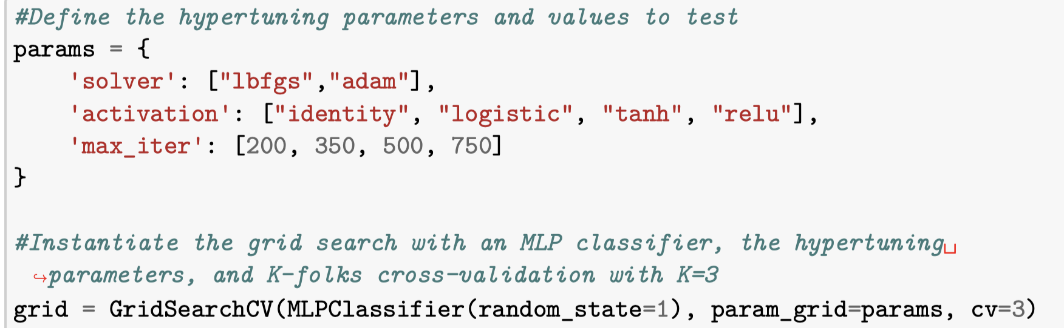
Hyperparameter Tuning
Max iterations
750: the model will run for a maximum of 750 epochs
Activation
relu: the function f(x) for the hidden layer will be f(x) = max(0,x)
Solver
adam: weight optimization will use a stochastic gradient-based optimizer

Slide 13
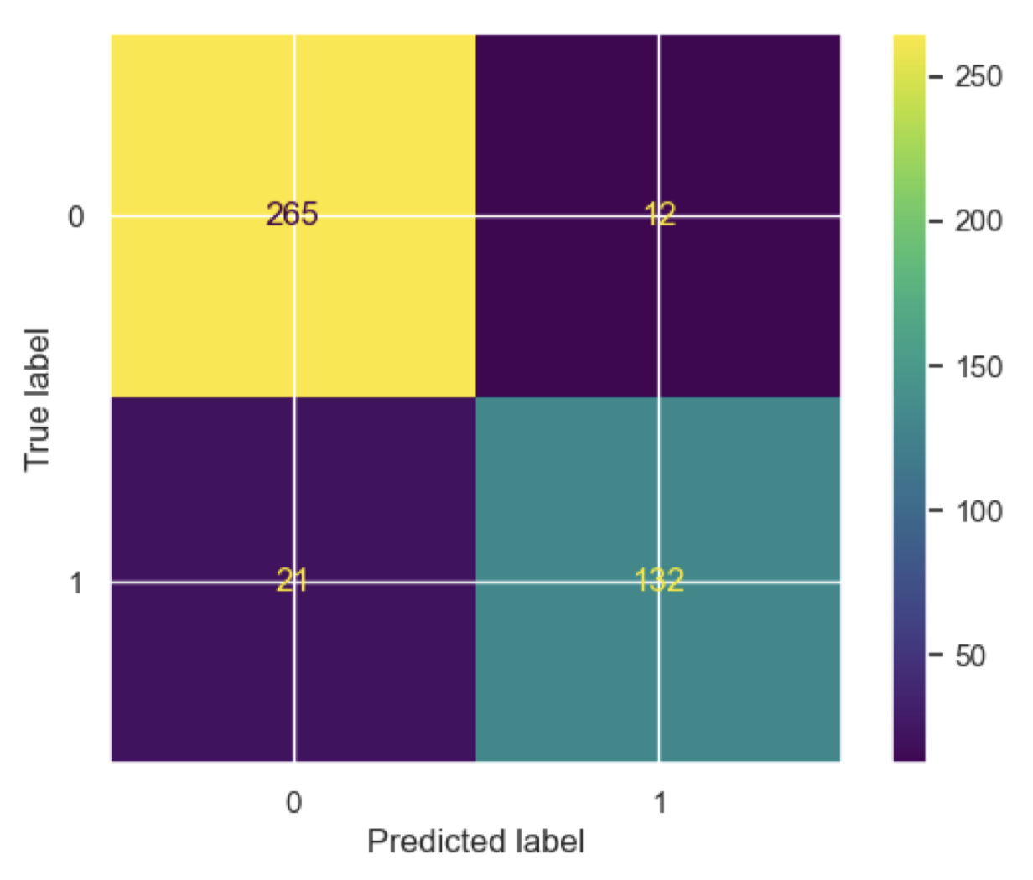
Evaluation
Accuracy: 0.923
7.7% incorrect
Precision: 0.917
8.3% of positive predictions incorrect
2.8% false positives
4.9% false negatives

Slide 14
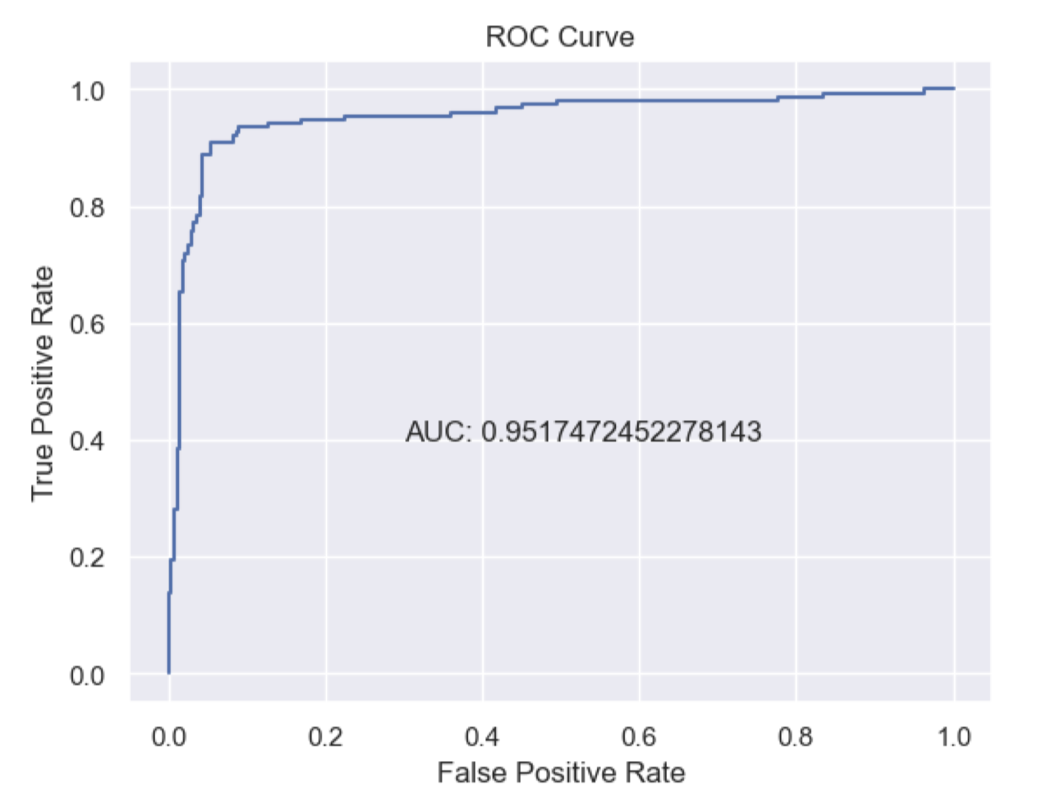
Area Under the Curve

Slide 15
Summary
Multi-layer perceptron classifier
Tuned hyperparameters
Accuracy: 0.923
Precision: 0.917
AUC: 0.952
Could benefit from consulting domain expert

Slide 16
Thank you

